Slide 1
Data Mining - W7
Decision Trees & Random Forests

Slide 2
Announcement
New Syllabus
Mid-term Postponed
Week 7
Logistics of Online Learning
Zoom 101 & Guidelines ( 3 simple points)
Mute, No Videos, Raise (MNoR)
Discussions: Slack Channel

Slide 3
Take advantage of DataCamp
Your unlimited access to the platform will be expired in May
Look at different modules that would help you advance your skills
Examples:

Slide 4
Content
Supervised Machine Learning
Classification Problem
Logistic Problem
Unsupervised Machine Learning
K-nearest Neighbor
Support Vector Machine (SVM)
Decision Trees
Classification Tree
Regression Tree

Slide 5
Introduction to Machine Learning
Supervised Machine Learning
Unsupervised Machine Learning

Slide 6
Supervised Machine Learning
A subfield of Machine learning
You train a model using input data to predict a given outcome
The setup often looks like following:
X: factors, variables
Y: outcome

Slide 7
Unsupervised Machine Learning
A subfield of Machine learning
You train a model using ONLY input data
There is no output data, or there is no outcome variable!
The setup is as follows:
X: variables, inputs, factors

Slide 8
Quiz 1: Which of these is a Supervised ML problem
Predict price of a stock given its historical data
Create clusters of documents that you have in your hardware
Predict if someone has Covid-19 or not based on previous data of similar patients

Slide 9
Tree-Based Models
Easy to use
Easy to interpret
Easy to implement
High accuracy

Slide 10
Classification and Regression Problem
Classification - outcome is 0/1, or categorical
Regression:

Slide 11
Quiz: Which of these is a classification problem?
Given a student’s past performance in different classes, predict the exact GPA that they would get for the current semester
Given a large dataset of user behaviors on Reddit, generate an informative segmentation of the users based on their behaviors
Predicting whether a given student will go to college or not based on their GPA, SAT scores, and other factors
Given a human resources department’ past data, and current resume dataset, present them with a series of recommended candidates to interview next

Slide 12
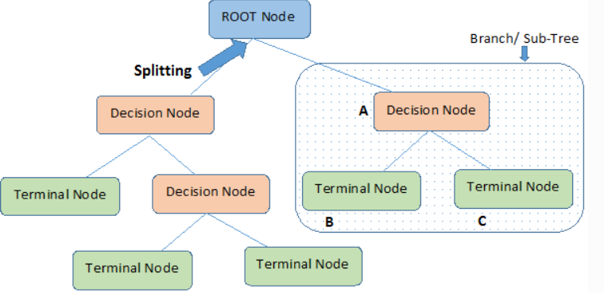
Decision Trees

Slide 13
Classification Trees
Outcome is a binary variable (0/1) or (Y/N)
Numeric data
Example: Whether a person gets accepted into college or not, whether someone gets scholarship or not, or whether a person is tested postive for Covid19
Treat Missing Data (drop them is one way to do this)
Can handle fairly large datasets
Large, big trees are difficult to interpret
Overfit data

Slide 14
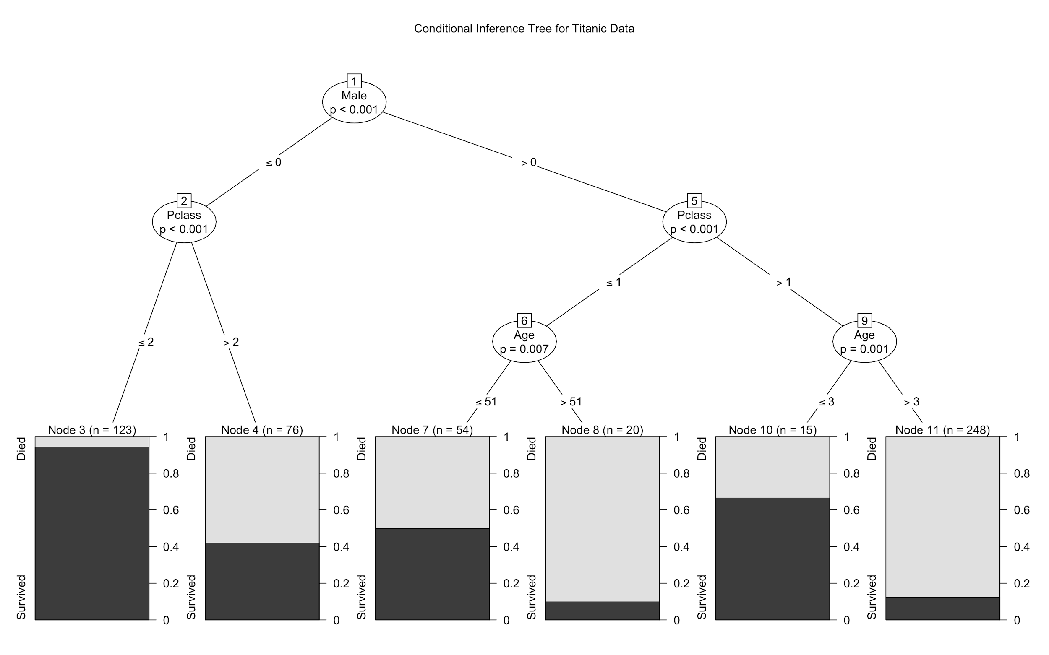

Slide 15
Building Your Model
In the OLS/ logistics regression class, we use all of our dataset to create different regression models. We often do this by trying out different predictive variables
The way that models are trained in ML is that we divide the dataset into two parts: Training and testing

Slide 16
Training the Model
install.packages('rpart')
library(rpart)
fit <- rpart(Survived ~ Age + Male + Pclass, data = train,
control = rpart.control(minsplit = 20, minbucket = 5))

Slide 17
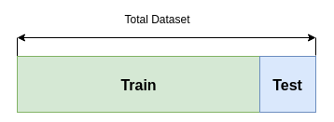
Evaluating Your Model: Holdout Method

Slide 18
Holdout method
Training vs. test sets can be split: 80/20, 70/30 or 75/25
This is to prevent model from overfitting the data
advanced machine learning models can remember the entire training set
This leads to overfitting the dataset if there’s no test set to check the model performance

Slide 19
Evaluate Your ML model
After training a model, you get the predicted values
And then evaluate your predicted values with the holdout or test set
In this class we use:
Accuracy
Confusion Matrix

Slide 20
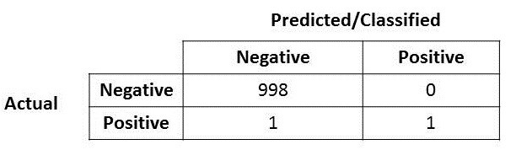
Accuracy - Confusion Matrix
Measures how the model predicts the class correctly

Slide 21
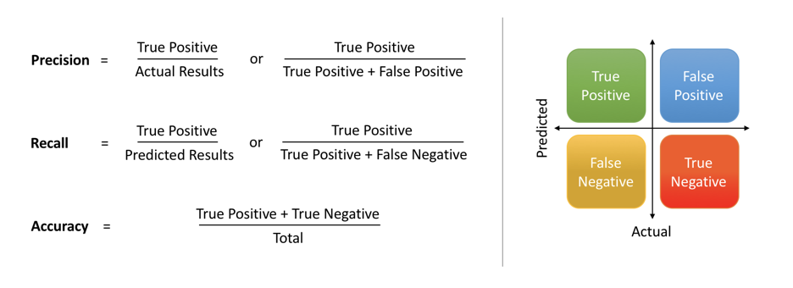

Slide 22
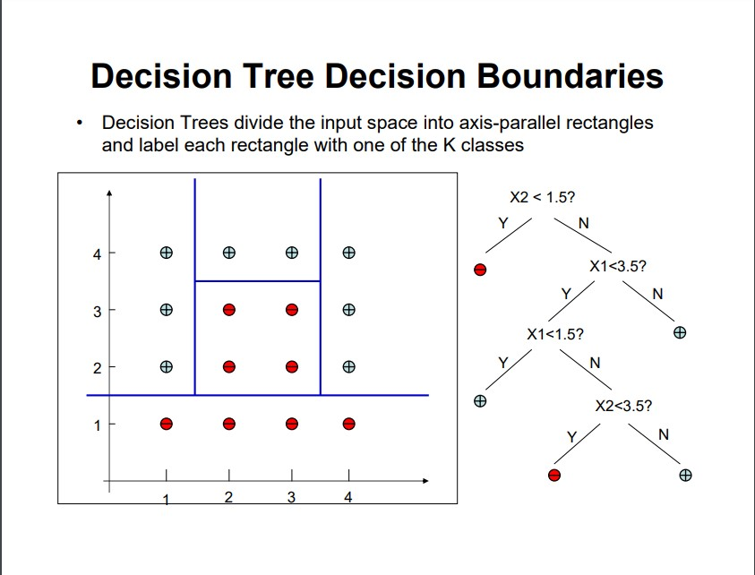
Splitting the Tree
Decision Boundaries
Partition regions of data

Slide 23
Regression Tree
Outcome is numeric (real or integer)
Outcome is not binary
For example: grade of students in a final test, number of people who have gotten Covid-19 in New York

Slide 24
Modeling
Similar to a classification tree
Also splitting the data into training and test sets
Build a model using training data, and then test the model using the test set

Slide 25
Model Building
install.packages('rpart')
library(rpart)
regressor = rpart(formula = Salary ~ .,
data = dataset,
control = rpart.control(minsplit = 1))

Slide 26
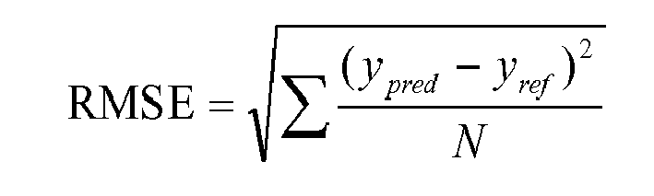
Evaluation

Slide 27
Decision Tree Hyperparameters
fit <- rpart(Survived ~ Age + Male + Pclass, data = train,
control = rpart.control(minsplit = 20, minbucket = 5))

Slide 28
Hyperparameters
minsplit: minimum number of data points required to attempt a split
cp: complexity parameter
maxdepth: depth of a decision tree

Slide 29
Pruning a Tree
Reduce the size of decision Trees
Remove Sections of the tree that provide little power to classify instances
Reduce complexity of the final classifier
Improve accuracy by reduction of overfitting
pfit <- prune(fit, cp=fit$cptable[which.min(fit$cptable[,"xerror"]),"CP"])

Slide 30
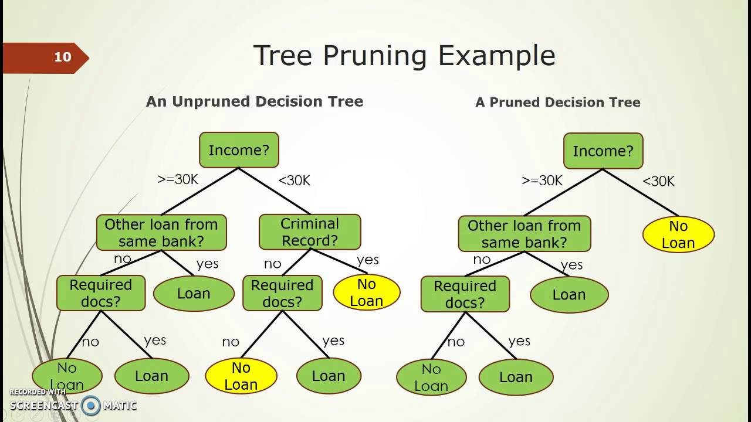

Slide 31
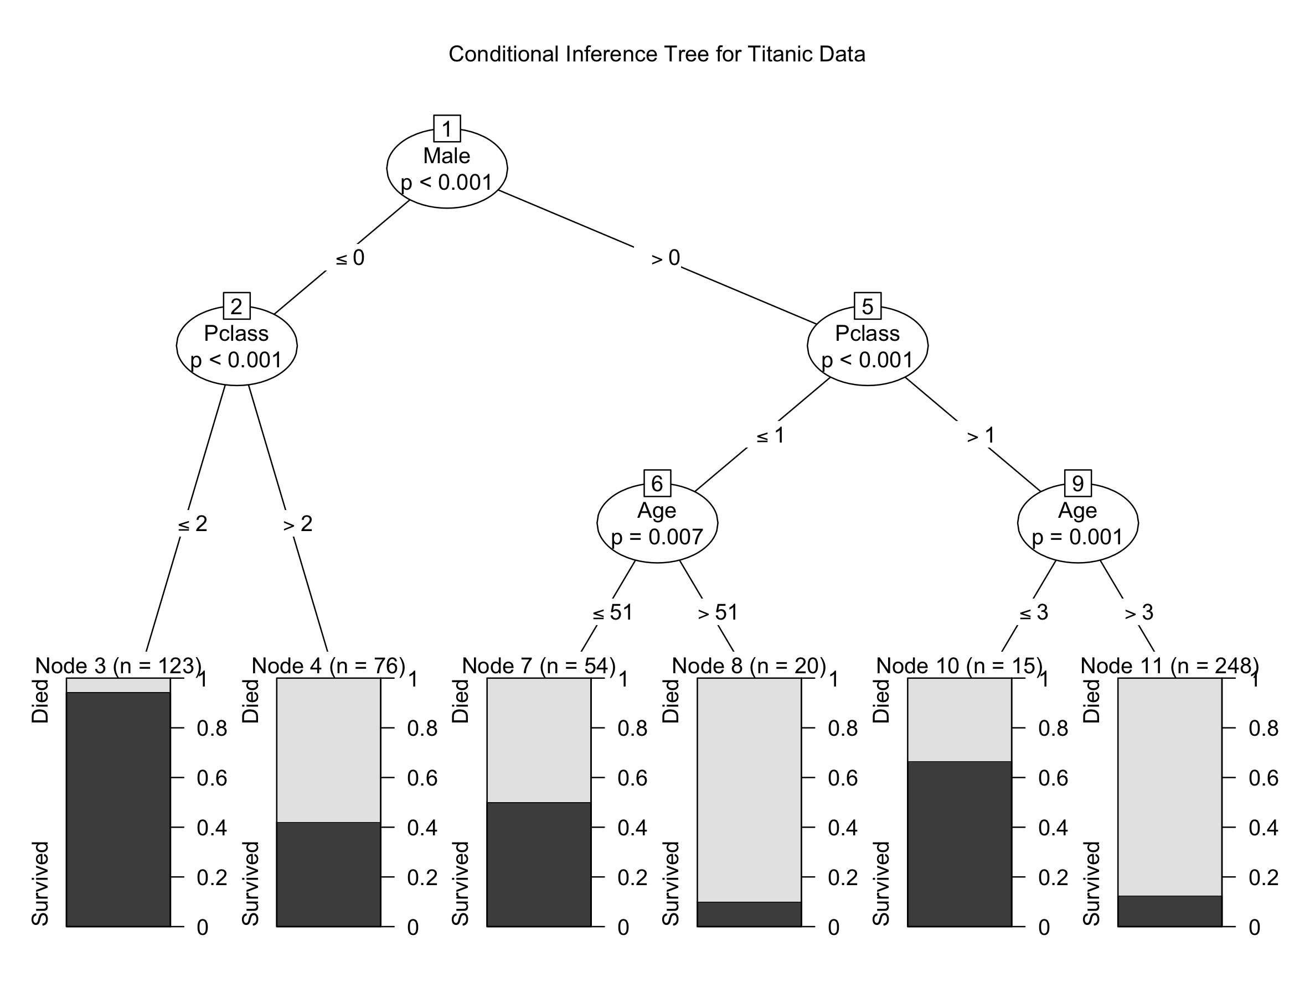

Slide 32
Homework
Classification Trees on DataCamp
Regression Trees on DataCamp

